Slide 1
Azure and Office 365 DevCamp - Overview

Slide 2
Course Goals
Provide a jumpstart on development for Azure and Office 365
Understand the options for your platform of choice
Windows, Linux, OSX
CODE, CODE, CODE

Slide 3
Microsoft
Cloud
Docker

Slide 4
Microsoft Cloud
Secure Productive Enterprise &
Operations Management + Security
Cortana Intelligence Suite
Office 365
Dynamics
Azure
PRODUCTIVITY
BUSINESS APPS
SECURITY & MANAGEMENT
DATA & INTELLIGENCE
APPLICATION INNOVATION

Slide 5
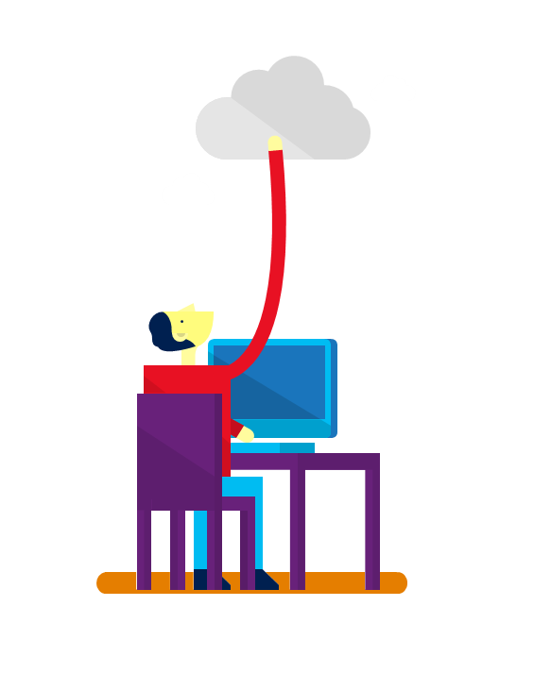











7+ billion
worldwide queries each month
50+ billion
minutes of connections handled each month
250+ million
active users
85%
Fortune 500 users
2.4+ million
emails per day
30+ trillion
objects stored
3.5+ million
subscribers
48+ million
users in 41 markets
50+ million
active users
400+ million
active users
18+ billion
Active Directory authentications per week
200+ Cloud Services
1+ billion customers · 20+ million businesses · 90+ markets worldwide

Slide 6
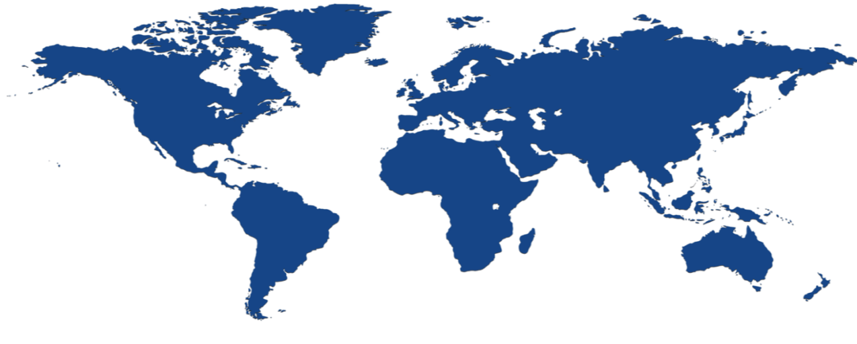


Achieve global scale, in local regions
34
regions
Over 1M+ production servers Dark fiber network 24 x 7 x 365 support
Notes:
The security controls we apply to development, infrastructure, operations, and compliance apply to our global customer base. Customers can explicitly choose which regions to deploy and store their data according to local privacy, security, or compliance requirements.
On this slide you can see the 34 regions where we operate (26 are active), including:
Public cloud regional datacenters with geographic diversity. Customers can deploy two identical workloads in different regions with an Active/Active failover model. This can ensure business continuity in the event of a local disaster.
Local and sovereign cloud. In-country Microsoft datacenters address data residency requirements, and we’re using a combination of technology as well as a legal framework to legally isolate certain regions of the world according to local sovereignty, governance, and rule of law, all the while providing the same exact up to date set of services in those regions.
There are four sovereign clouds today and four more planned, including Germany for example, as well as:
US Gov (2)
China North Beijing
China South Shanghai
Planned:
Germany Central
Germany Northeast
US DoD East
US DoD West

Slide 7
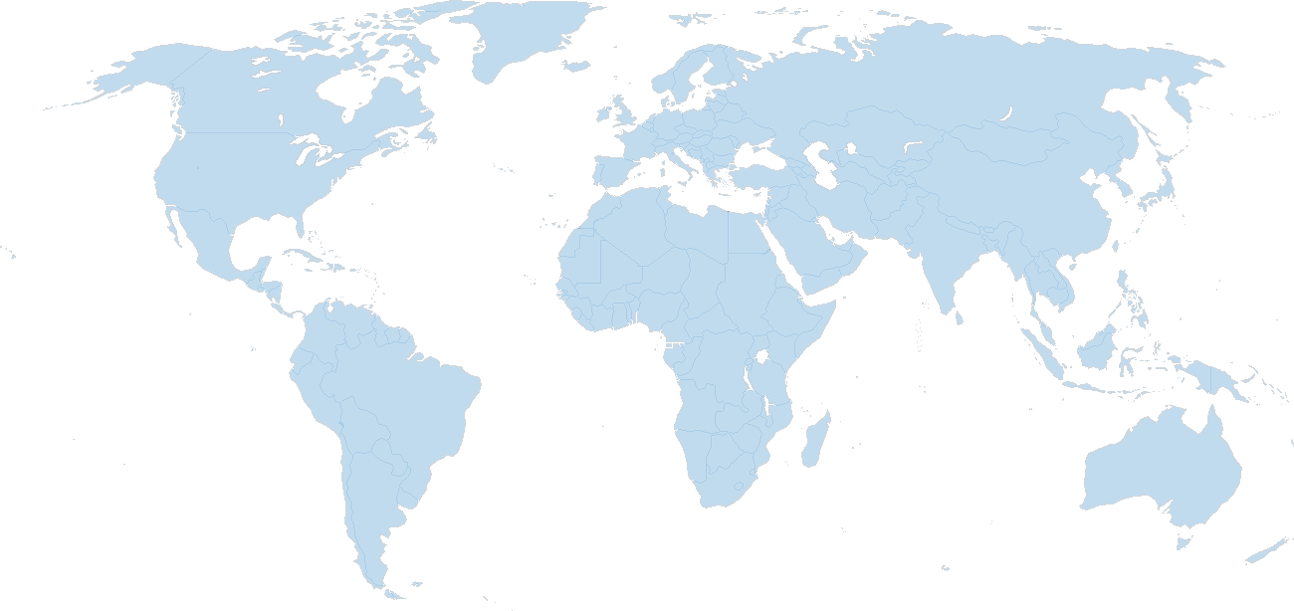
Global Datacenter Presence
North America Region
Europe Region
Asia Pacific Area
N. Europe
U.S. N. Central
NE. China
U.S. West
U.S. East
W. Europe
East Japan
West Japan
U.S. S. Central
E. China
E. Asia
S.E. Asia
Major datacenter
LATAM
East Australia
Southeast Australia
Over 1M+ production servers Dark fiber network 24 x 7 x 365 support

Slide 8
Momentum
120,000
New Azure customer subscriptions/month
150 billion
Azure SQL query requests processed/day
>85%
of Fortune 500 use Microsoft Cloud
715 million
Azure Active Directory users
120 billion
Hits to websites run on Azure Web App Service
Notes:
We’ve had incredible momentum in the last year with over 85% of Fortune 500 companies using the Microsoft Cloud.

Slide 9
Microsoft
Trust
Docker

Slide 10
Trusted Cloud principles
Commitment to principles worthy of your organization’s trust
Security
Privacy & control
Compliance
Transparency
We will implement strong security measures to safeguard your data.
We will provide you with control over your data to help keep it private.
We will help you meet your specific compliance needs.
We will explain what we do with your data in clear, plain language.

Slide 11
Defense in depth
Security Management
Data
Threat and vulnerability management, security monitoring, and response, access control and monitoring, file/data integrity, encryption
User
Account management, training and awareness, screening
Application
Secure engineering (SDL), access control and monitoring, anti-malware
Host
Access control and monitoring, anti-malware, patch and configuration management
Internal network
Dual-factor authentication, intrusion detection, vulnerability scanning
Network perimeter
Edge routers, firewalls, intrusion detection, vulnerability scanning
Facility
Physical controls, video surveillance, access control

Slide 12
Privacy responsibilities in the services world
Data subject: a person whose data is being transmitted/processed/stored
Data controller: a person or company who decides how data will be used in the service
Data processor: a person or company that takes action on data according to the data controller’s instructions
Users are the data subjects
Customer/tenant admin is the data controller
Microsoft is the data processor

Slide 13
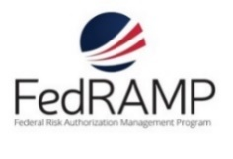
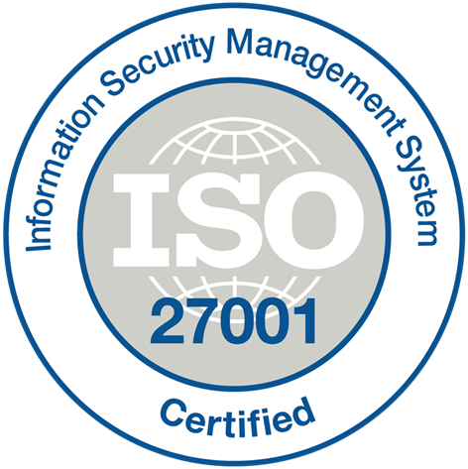
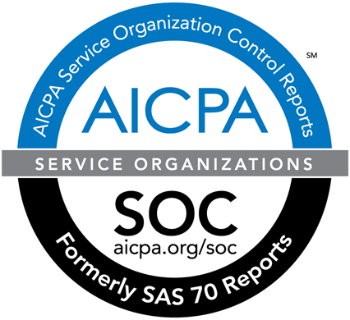

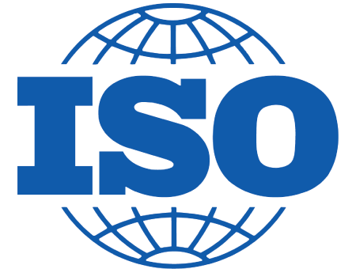



















Global compliance with focus
Foundational
FedRAMP JAB P-ATO
SOC 1 Type 2
SOC 2 Type 2
Cloud Controls Matrix
ISO 27018
ISO 27001
Industry
HIPAA / HITECH
FIPS 140-2
21 CFR
Part 11
FERPA
DISA Level 2
CJIS
IRS 1075
ITAR-ready
Focused
European Union
Model Clauses
EU Safe Harbor
United Kingdom
G-Cloud
China Multi
Layer Protection Scheme
China
GB 18030
China
CCCPPF
Singapore
MTCS Level 1
Australian Signals
Directorate
New
Zealand
GCIO
Japan
Financial Services
ENISA
IAF

Slide 14
Transparency
At Microsoft, our strategy is to consistently set a “high bar” around privacy practices that support global standards for data handling and transfer.
Where is data stored?
Clear data maps and geographic boundary information provided.
‘Ship To’ address and/or some SKU purchase determines physical location you are provisioned.
Who accesses and what is accessed?
Core customer data accessed only for troubleshooting and malware prevention purposes.
Core customer data access limited to key personnel on an exception basis.
How to get notified?
Microsoft notifies you of changes in datacenter locations and any changes to compliance.

Slide 15
Microsoft
Hybrid
Docker

Slide 16
Extend on-premises data and apps
Storage | StorSimple + Azure Storage
Backup + DR | Azure Backup + Azure Site Recovery
Database | SQL Server 2016 Stretch DB + Azure SQL DB
App integration | Azure Service Bus + BizTalk
Identity | Azure Active Directory
Cloud management | Operations Management Suite + System Center
Networking | VPN + ExpressRoute
Hybrid
Notes:
ALTERNATE Hybrid Cloud Slide
With Azure, you can take the investments you’ve made in data and intellectual property, and extend from on-premises to the cloud, or vice versa.
Companies fall into two main buckets with regards to hybrid: those who are using hybrid solutions as a temporary bridge to the cloud, and companies who are architecting hybrid solutions for use in perpetuity.
Amongst each of these types of customers, there are common use cases such as:
Application Availability
Bottomless Storage
Identity Management
Full hybrid applications
But—this isn’t easy. That’s why we support hybrid solutions across key elements for hybrid: networking, identity, data, and apps.
[need combos of the displayed features to talk to the use cases]
Finally, Azure’s hybrid cloud capabilities support an open ecosystem:
Azure Marketplace
RedHat Linux on Azure
Hosters
Support for OSS App Platforms, languages, frameworks

Slide 17
Extend on-premises data and apps
Hybrid Use Cases
Seamless & secure across:
Application Availability
Bottomless Storage
Identity Management
Full hybrid applications
INFRASTRUCTURE
Azure Backup
Azure Site Recovery
DATA
Azure StorSimple
SQL Server Stretch DB
USERS
Azure Active Directory
APPS
App Service
Web | Mobile | Logic Apps | API Apps
MANAGEMENT
Operations Management Suite
Notes:
With Azure, you can take the investments you’ve made in data and intellectual property, and extend from on-premises to the cloud, or vice versa. Azure provides the portability to move your technology investments, whether open source or not, from cloud to on-premises and vice versa.
Companies fall into two main buckets with regards to hybrid: those who are using hybrid solutions as a temporary bridge to the cloud, and companies who are architecting hybrid solutions for use in perpetuity.
Amongst each of these types of customers, there are common use cases such as:
Application Availability
Bottomless Storage
Identity Management
Full hybrid applications
We provide seamless, secure hybrid cloud capabilities across infrastructure, data, users, apps, and management.

Slide 18
Deploy the cloud on-premises
Azure Stack
Portal | PowerShell | Dev-ops tools
Portal | PowerShell | Dev-ops tools
One Azure ecosystem
Azure Resource Manager
Azure Resource Manager
Unified app development
Azure IaaS | Azure PaaS
Azure IaaS | Azure PaaS
Compute | Networking | Storage
App Service | Service Fabric
Azure services in your datacenter
Cloud infrastructure
Cloud-inspired infrastructure
Microsoft Azure
PUBLIC
Microsoft Azure Stack
PRIVATE | HOSTED
Notes:
Azure Stack provides the capabilities of Azure for customers who want to host it on their own premises. The Azure portal acts as a hub for managing between cloud and on-premises.
On the left hand side, you have Microsoft Azure as a public cloud offering. Note that on the right, with Azure stack, the parity between key elements:
Portal | PowerShell | Dev-ops tools provide the same end user experiences and same app model.
Azure Resource Manager lets you build reusable application templates for traditional and cloud-native apps.
Azure IaaS and PaaS services are available in both for unified app dev.
On the infrastructure layer, we are making some translation – Azure runs on hyper-scale (each scale unit is 20 racks!) while you folks likely run a lesser footprint. So we’re doing some work to make this fit into your environments.
This provides some key benefits across roles:
Application developers can maximize their productivity using a ‘write once, deploy to Azure or Azure Stack’ approach. Using APIs that are identical to Microsoft Azure, they can create applications based on open source or .NET technology that can easily run on-premises or in the public cloud. They can also leverage the rich Azure ecosystem to jumpstart their Azure Stack development efforts.
IT professionals can help transform on-premises datacenter resources into Azure-consistent IaaS and PaaS services, thereby maximizing agility and efficiency. End users can quickly provision services using the same self-service experience as Azure. IT gets to use the same automation tools as Azure to control the service delivery experience.
Business leaders can truly take advantage of cloud on your terms.

Slide 19
Microsoft
OSS
Docker

Slide 20

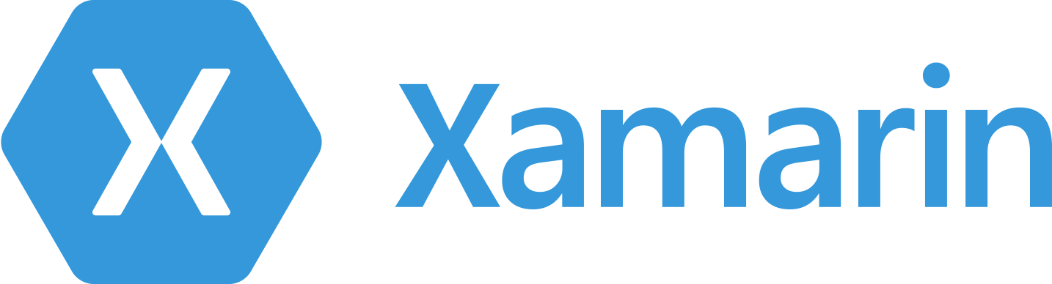



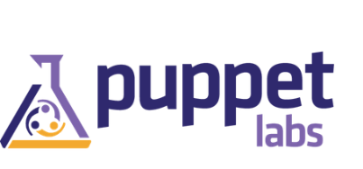

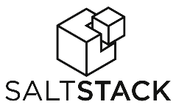









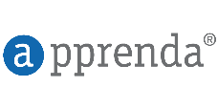
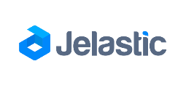
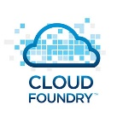
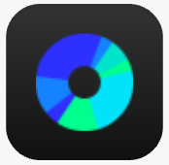



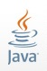








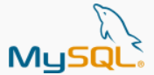

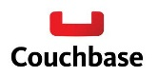





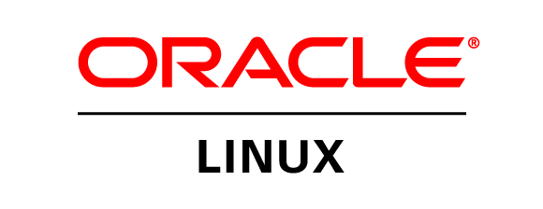
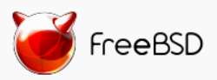


Azure is an open cloud
Public Cloud
DevOps
Clients
Management
Applications
PaaS &
DevOps
App Frameworks
& Tools
Databases &
Middleware
Infrastructure

Slide 21
Broad Linux and open source investment
Hyper-V
System Center and OMS
Microsoft Azure
Growing engagement across Microsoft teams
Each team does what’s right for its customers
Big Data and Analytics
SQL Server
.NET Core
DevOps and Release Mgmt
Windows Client

Slide 22


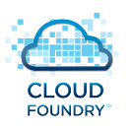

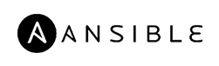


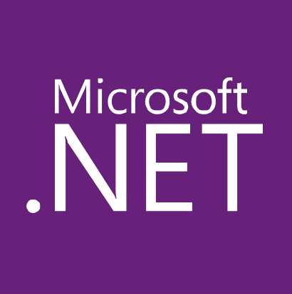

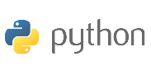
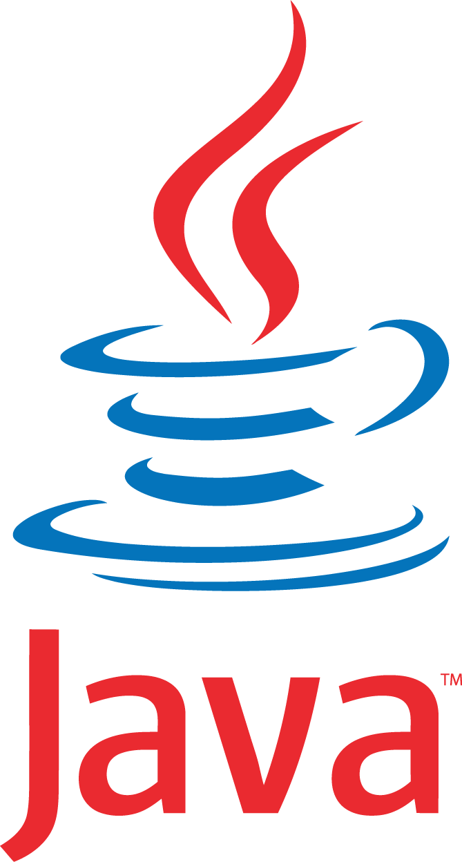



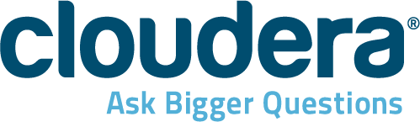




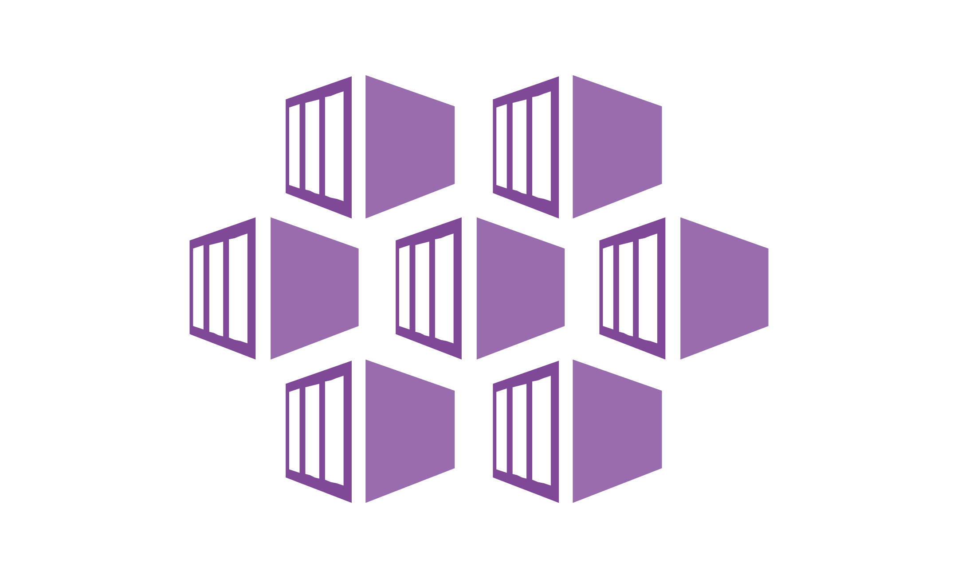

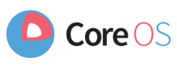
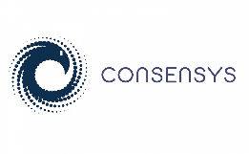
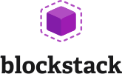



Build and run open source solutions
Any tool, application, framework
Applications
DevOps
Frameworks
Databases & middleware
Containers
Infrastructure
Notes:
We’re heavily invested in open-source technologies and partnerships, as evidenced on this slide. Nearly one in three Azure virtual machines are now running Linux, and we support Linux as a first class citizen.
Why is this important to Microsoft? Because it’s in the best interest of our customers. In fact, over 40% of CIOs are using open source as their primary strategy heading into 2017. We support our customers’ computing, whatever it is and wherever it is.
Finally, we contribute to the open source community as well as build some of our services on open source technology, like HDInsight and Azure Container Service. This also helps us scale to our customers’ needs as we rapidly release cloud solutions.

Slide 23


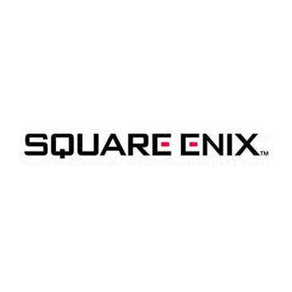


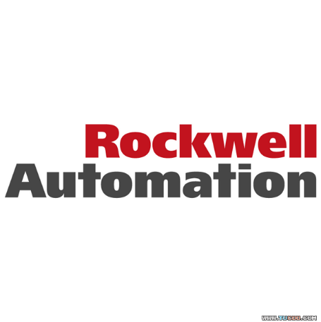







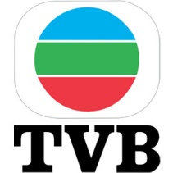

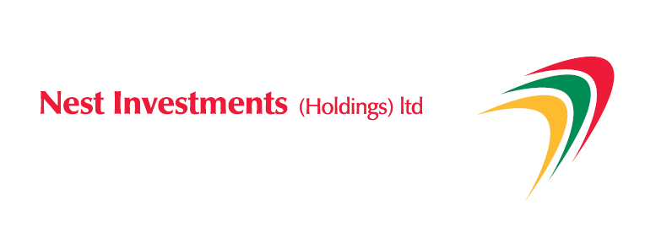

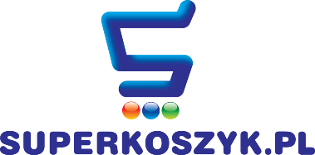


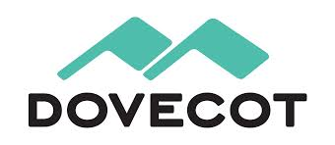

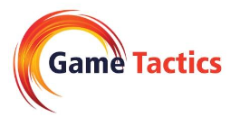






Open Source on Azure Customers
More customer stories at customers.microsoft.com!

Slide 24
Microsoft
DevOps
Docker

Slide 25


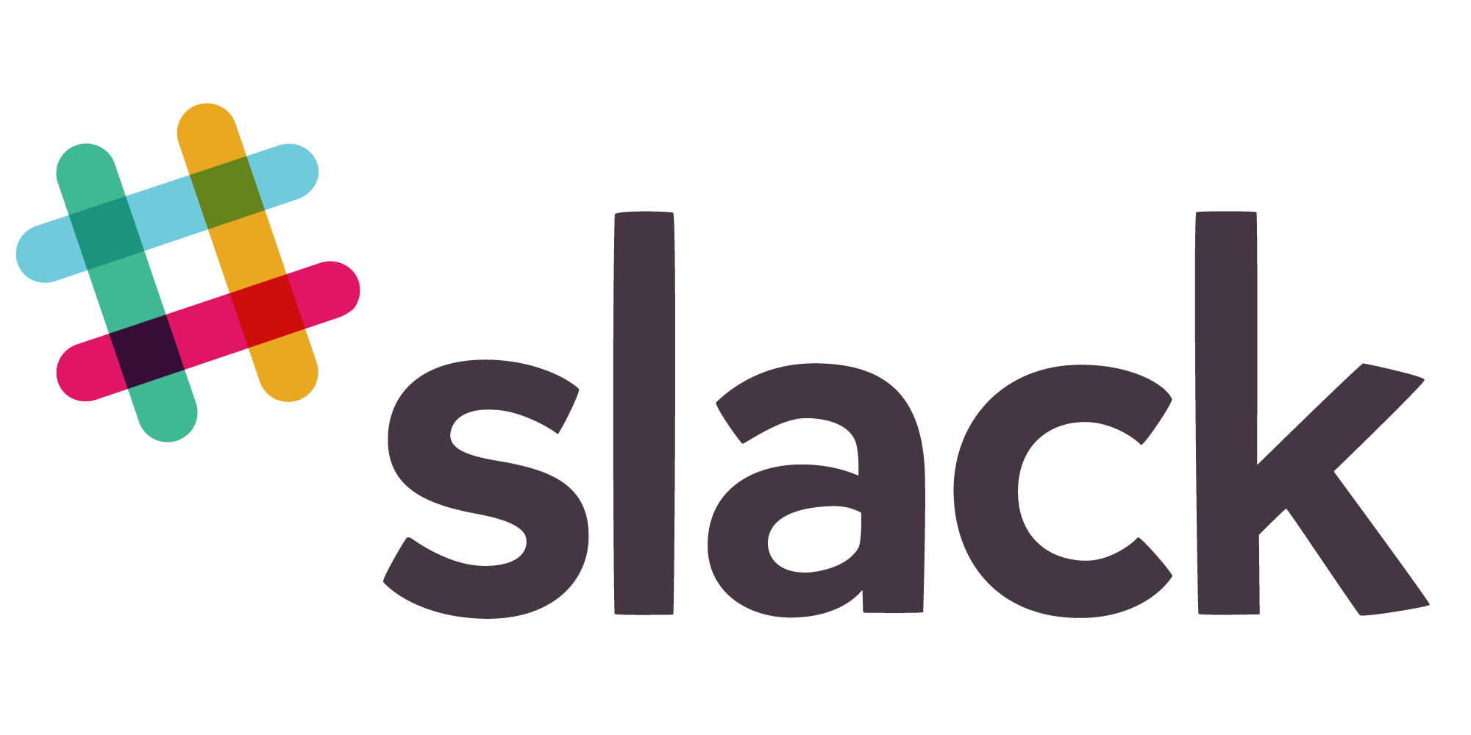
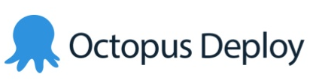





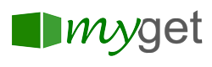

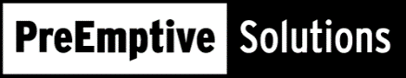



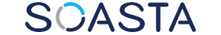

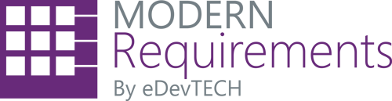


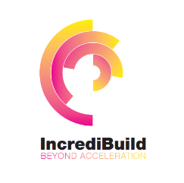







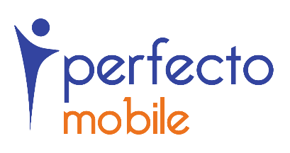
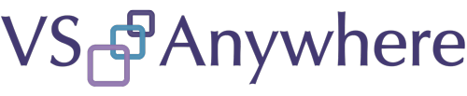
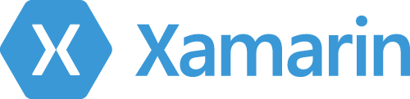
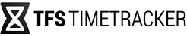


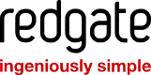
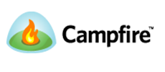

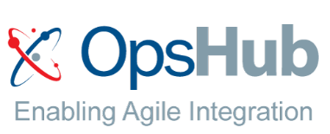

Open + Flexible Tool Chain
65
Visual Studio Code Extensions
5,910
Visual Studio Gallery Extensions
90
Visual Studio Sim-Ship Partners
48
VS Team Services Extensions
1,177 Visual Studio Code Extensions
6,538 Visual Studio Gallery Extensions
90 Visual Studio Sim-Ship Partners
171 VS Team Services Extensions
Notes:
Main point to land – VSTS/TFS is open, flexible, and integrates with your tools and if the integration isn‘t there yet you can build it in our marketplace. You can go all-in OR just pick the bits and pieces of functionality you‘d like to use.
Tasks are open source on GitHub.
Optionally choose some partners to highlight which resonate with your local audience. i.e. If you want to use GitHub for your source code and then use VSTS for builds you can do this. You can use Jenkins for builds and use VSTS for release management.

Slide 26


Build apps faster and easier
Build on PaaS
Azure
Internet of Things
Azure Marketplace
Existing frameworks
Web and mobile
Microservices
Serverless Compute
Build on IaaS
Virtual machines
Storage
Networking
Notes:
Building apps faster and easier means using the right building blocks for the job.
Starting from the bottom left, our core building blocks are storage, computing, and networking, or Infrastructure-as-a-Service, which provides customers with agility and cost savings.
When you add our integrated platform services, which run IaaS on the back-end, customers accelerate that agility. A recent study showed that customers using our platform as a service for app dev estimate 466% ROI than on just IaaS alone. This includes services across apps both small and internet-scale, data, integration, and so on.
In the middle, we’re packaging up services and capabilities to deliver preconfigured solutions such as with Azure IoT Suite. IoT is not a new concept in our industry, but it is extraordinarily difficult to deliver and maintain. In the past several years, the technology required to facilitate IoT solutions has improved dramatically, making it more accessible across industries and scenarios. Our IoT preconfigured solutions aim to further amplify that momentum, allowing companies to get to a working proof of concept in a fraction of the time than if they were building with individual components from scratch.
Finally, you can leverage full templates for web, mobile, containers, etc.--both first and third party--to get started in minutes rather than hours and days, through the Azure Marketplace. The screenshot here is our gallery of container templates, ranging from Docker to Mesosphere.

Slide 27


Build a Flexible DevOps Pipeline
Streamline the development of your apps
Frequently releasing value to users
Constantly maintaining quality
Monitoring app health and engagement in real-time
Automate the process to be repeatable & sustainable
Continuous Integration (CI)
Continuous Delivery (CD)
Continuous Monitoring (CM)
Repository
Build
Automated Testing
Code
Engagement
Monitoring
Distribution

Slide 28
Microsoft
Containers
Docker

Slide 29

Azure Container Service
Public Cloud
Get a cluster of VMs pre-configured to run containers
Containers are in Docker container format
GA now for Linux containers, running on Ubuntu Linux VMs
Private preview for Windows containers, running on Windows VMs
Scale/orchestrate using Mesos DC/OS or Docker Swarm
Exposes standard API endpoints
Use your favorite popular open source tooling
Full portability to migrate containers to and from Azure

Slide 30
Docker + Windows Server = Windows Containers
Native Windows containers powered by Docker Engine
Windows kernel engineered with new primitives to support containers
Deep integration with 2+ years of engineering collaboration in Docker Engine and Windows Server
Microsoft is top 5 Docker open source project contributor and a Docker maintainer
App
App
App
Bins/Libs
Bins/Libs
Bins/Libs
Docker Engine
Windows Server 2016
Infrastructure

Slide 31
Hyper V Containers = Docker + Windows Server
Leverages same Docker and Windows Server technology
Flexible container deployment options available for IT pros
One workload per Hyper V container delivers added isolation for multi-tenant or hostile environments
Hyper V container
Windows containers
App
App
App
Bins/Libs
Bins/Libs
Bins/Libs
WS Kernel
Docker Engine
Windows Server 2016
Infrastructure

Slide 32
Azure & Office 365 2-Day DevCamp

Slide 33
Course Agenda
Module 1
Module 2
Module 3
Module 4
Module 5
Module 6
Module 7
Setting up your developer environment
Building modern cloud apps
Identity with Azure AD and Office 365 APIs
DevOps with Azure and Visual Studio Team Services
Monitoring applications with App Insights
Introduction to Docker and Azure container service
Partner programs (App Source, Market place and CSP)

Slide 34
Hands on labs
HOL 1
HOL 2
HOL 3
HOL 4
HOL 5
Setting up your developer environment
Building modern cloud apps
Identity with Azure AD and Office 365 APIs
DevOps with Azure and Visual Studio Team Services
Infrastructure as code with Azure Resource Manager (ARM)
HOL 6
Monitoring applications with App Insights

Slide 35
Day 1 – Detailed Agenda
9:00 AM – 9:30
Overview
9:30 – 10:00
Tools and developer environment overview Lecture + Demo
10:00 – 10:30
HOL 1 - Tools and Developer Environment Setup
10:30 – 10:45
Break
10:45 -11:15
HOL1 - Tools and Developer Environment Setup (Cont'd)
11:15 - 12:00 PM
Modern Cloud Apps Lecture + Demo
12:00 -1:00
Lunch
1:00 - 2:30
HOL 2 - Modern Cloud Apps
2:30 - 2:45
2:45 - 3:45
Identity and Office365 APIs Overview Lecture + Demo
3:45 - 4:45
HOL 3 - Identity and Office365 APIs
4:45 - 5:00
Break
Q&A

Slide 36
Day 2 – Detailed Agenda
9:00 AM-9:15
10:00 - 10:15
10:15 - 11:15
12:00 - 1:00
4:00 - 4:45
5:15 - 5:30PM
Recap
9:15 - 10:00
Q&A
AppSource, Market Place, CSP Lecture + Demo
Containers (Docker, ACS) Lecture + Demo
4:45 - 5:15
HOL 6 - Monitoring applications with App Insights
Monitoring Lecture + Demo
3:00 - 4:00
Break
2:15 - 3:00
HOL 5 - Infrastructure as code (ARM)
2:00 - 2:15
Lunch
1:00 - 2:00
Infrastructure as code (ARM) Lecture + Demo
HOL 4 - Continuous integration
11:15 - 12:00 PM
Break
Continuous integration Lecture + Demo

Slide 37
Demo – Sample Application

Slide 38
App Architecture
Front end
HTML
NODE/JS
.NET
Java
Services
WebAPI-CRUD
Services
DB
Image Resize using Azure Functions
Office
Blob Storage
Office
DocDB

Slide 39
Components Covered in this Course
Azure
Azure Resource Manager
Virtual Machines (Windows & Linux)
Azure AD
Web Applications
API Apps
Redis Cache
Document DB
Office 365
Graph API (users, OneDrive for Business, Skype for Business)
Visual Studio Team Services
Source Control integration (GIT)
Continuous Integration & Delivery
Containers
Docker
Azure Container Service

Slide 40

Questions?

